Slide 1
Chapter 1 – Algorithm Analysis
Contents
Introduction to computing
Algorithms
Experimental analysis
Pseudocode
Random access machine
Functions in algorithm analysis
Asymptotic analysis
Asymptotic notation
Big-Oh, Big-Omega, Big-Theta, Little-Oh, Little-Omega
Examples
Search
Prefix averages
Maximum contiguous subsequence sum
Java and Eclipse
©This course material was prepared and is owned by Dr. Luis Rueda. It shall not be reproduced or used without permission

Slide 2
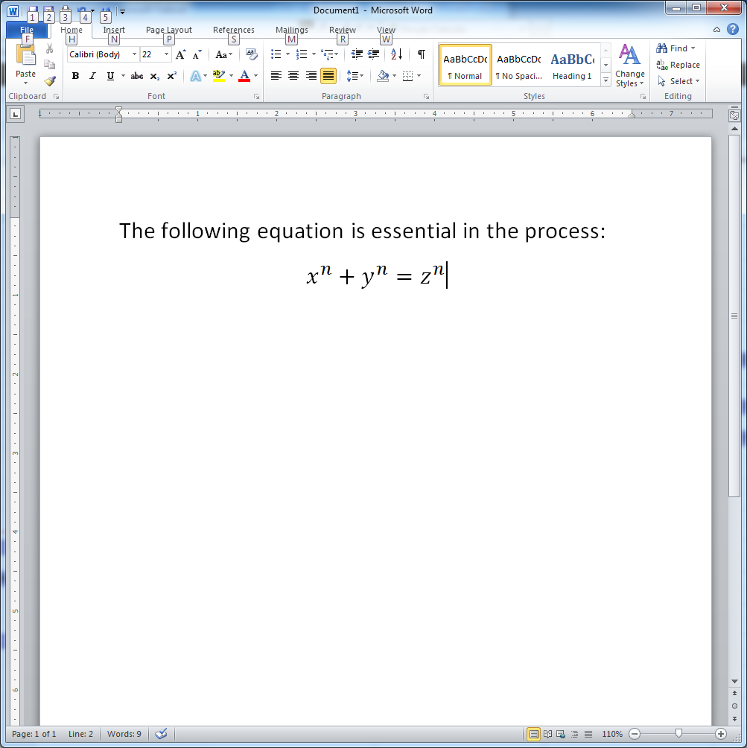
Computing: What is computer science?
My computer crashed ☹
How do I fix it?
How do I insert an equation in MS Word? ☺
None of these!

Slide 3
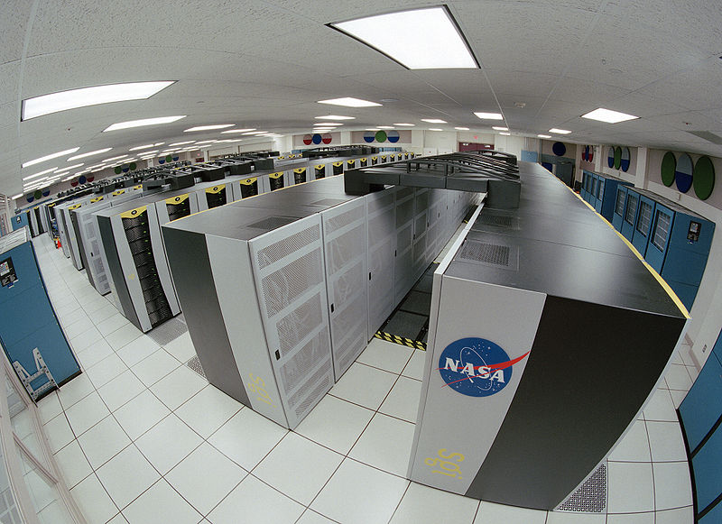

Abstract vs. Real Computer
Abstract computer:
Turing machine (TM)
Real computers:
NASA’s supercomputer My little smartphone
Control unit:
q
Infinite tape:
. . . B B 0 0 1 B . . .
TMs and Computers are structurally different but equivalent:
They do exactly the same!
A TM solves/decides problems/languages:
Recursive languages
A problem/language is recursive if:
There is an algorithm that solves/decides it
Notes:
Though they do things at different speed and process different amounts of data,
NASA’s supercomputer and my little smartphone have a common limitation: they both decide recursive languages.
But they don’t decide recursively enumerable languages.
A TM has an infinite tape
And so, an unbounded memory!
A Real Computer doesn’t though
But we can always expand its memory
We just need to get more $$$ though, and add more memory
Here, we’ll assume our computer has an unbounded memory
It’ll run any algorithm we can imagine, as long as it runs in finite time
We’ll call it Random Access Machine (RAM)

Slide 4
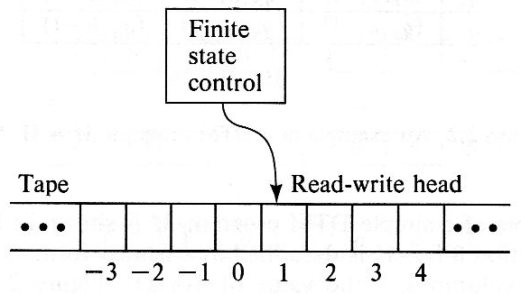
My own view of computing
Turing Machine (TM) – A. Turing, 1936
Abstract computing machine used for:
Real computations
Math definitions
Solve any computing (decidable) problem
Language
A set of strings from an alphabet
TM decides/solves any recursive language (= algorithm)
L = {100, 1000, 1100, 10000, 10100, … }
Context-free Grammars – N. Chomsky, 1956
Context-free languages (CFL) defined by context-free grammars
CFL are (a subset of) recursive languages
TM can then parse strings of CFLs
Σ = {0,1}, N = S = {P}
Productions:
P → ϵ | P → 0 | P → 1
P → 0P 0 | P → 1P 1
Program
A computer program can be seen as a string of a language (mainly CFLs)
First programming language: Fortran - 1955
public class Maximum {
public static void main(String[] args) { int currentMax = …; …
}
}
Algorithm
Written in pseudocode
Translated to any programming language
Key: complexity analysis - D. Knuth, 1962
Algorithm arrayMax(A, n)
currentMax ← A[0]
for i ← 1 to n − 1 do
if A[i] > currentMax then
currentMax ← A[i]
return currentMax
Notes:
The first model of computing was proposed in 1936 by Alan Turing. It is called the “universal model” for computing.
More details about it will be studied later in this course.
A context-free grammar defines a context-free language.
Most programming languages like Java, C/C++ are 99% context free.
The 1% is in little tricks and clinches to resolve some issues of ambiguity and implementation.
Though a program can be seen as a string in a language (e.g., my program is a string of Java).
An algorithm is better written in pseudocode.
Every algorithm written in pseudocode can be run in the RAM,
And translated into a program in a specific programming language.
Pseudocode helps understanding by omitting irrelevant details (e.g., libraries, semicolons, or details about primitive operations).

Slide 5

Algorithm
Definition: An algorithm is a sequence of steps used to solve a problem in a finite amount of time
Properties
Correctness: must provide the correct output for every input
Performance: Measured in terms of the resources used (time and space)
End: must finish in a finite amount of time
Input
Output
Notes:
Correctness:
An algorithm is correct if it solves the given computational problem.
For every input (set of values) it produces the desired output (another set of values)
The algorithm is correct if it terminates in finite time

Slide 6
Input size
Performance of an algorithm measured in terms of the input size
Examples:
Number of elements in a list or array A: n
Number of cells in an mxn matrix: m, n
Number of bits in an integer: n
Number of nodes in a tree: n
Number of vertices and edges in a graph: |V|, |E|
A
21 | 22 | 23 | 25 | 24 | 23 | 22
0 | 1 | 2 | 3 | 4 | 5 | 6
Notes:
In a tree, the input size could be the number of external nodes (leaves), or the number of internal nodes.
Strictly speaking, the input size is the number of bits used to store the data structure that contains the input data. For example, for a linked list, it will be the total number of bits used to store each node multiplied by the number of nodes in the list. Each node may contain several items, including links to the next and previous nodes, and a composite object for the element (e.g., employee number, name, address, etc.).
In case of a tree, the number of bits will be given by those in the element of each node, and the links for parent, children and other properties. The same applies to graphs, matrices, and other data structures.
In any case, the number of nodes of a tree or graph, or the number of elements in an array or matrix will increase proportional to the number of items in the data structure. The size of each node/element, will only change the input size by a constant. For theoretical (asymptotic) analysis, these constants are disregarded.
In case of an integer, it will be the number of bits, and possibly the sign. Floating point numbers may have some additional bits for the exponent and point.

Slide 7
Experimental vs Theoretical analysis
Experimental analysis:
Write a program that implements the algorithm
Run the program with inputs of varying size and composition
Keep track of the CPU time used by the program on each input size
Plot the results on a two-dimensional plot
Limitations:
Depends on hardware and programming language
Need to implement the algorithm and debug the programs
Notes:
Limitations of experimental analysis:
It is necessary to implement the algorithm, which may be difficult
Results may not be indicative of the running time on other inputs not included in the experiment.
In order to compare two algorithms, the same hardware and software environments must be used

Slide 8
Theoretical analysis – main framework
2. Write algorithm in pseudocode
Advantages:
Uses a high-level description of the algorithm instead of an implementation
Characterizes running time as a function of the input size, n.
Takes into account all possible inputs
Allows us to evaluate the speed of an algorithm independently of the hardware/software environment
max ← A[0]
for i ← 1 to n − 1 do
if A[i] > max then
max ← A[i]
return max
1. Problem
3. Count primitive operations
Given array A
Find max of A
T(n) = 8n – 3
5. Compare with other algorithms
4. Find asymptotic notation for T(n):
O, Θ,,Ω, ο, ω
Divide and conquer?
Recursive? Linear time?
T(n) is Θ(n)

Slide 9
Pseudocode
Control flow
if … then … [else …]
while … do …
repeat … until …
for … do …
Indentation replaces braces
Method declaration
Algorithm method (arg [, arg…])
Input …
Output …
return …
Method call
var.method (arg [, arg…])
Return value
return expression
Expressions
Assignment (like = in Java)
Equality testing (like == in Java)
n² Superscripts and other mathematical formatting allowed
Example: find max element of an array
Algorithm arrayMax(A, n)
Input array A of n integers
Output maximum element of A
currentMax ← A[0]
for i ← 1 to n − 1 do
if A[i] > currentMax then
currentMax ← A[i]
return currentMax
Pseudocode provides a high-level description of an algorithm and avoids to show details that are unnecessary for the analysis.
Notes:
Pseudocode provides a high-level description of an algorithm
It is more structured than English prose
But less detailed than a program
It is the preferred notation for describing algorithms
It hides program design issues
Pseudo code can be translated into any programming language
Java is the preferred programming language

Slide 10
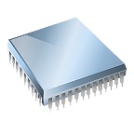
Random Access Machine (RAM)
It has a CPU – equivalent to that of a conventional computer
A potentially unbounded bank of memory cells
Each memory cell:
can hold an arbitrary number or character
is referenced by a number or index
Can be accessed in unit time
2
1
0

Slide 11
Most important functions used in Algorithm Analysis
The following functions often appear in algorithm analysis:
Constant ≈ 1 (or c)
Logarithmic ≈ log n
Linear ≈ n
N-Log-N ≈ n log n
Quadratic ≈ n²
Cubic ≈ n³
Exponential ≈ 2^{n}
In a log-log chart, the slope of the line corresponds to the growth rate of the function (except exponential)
n³
2^{n}
n²
T(n) = time
n log n
n
log n
c
n = size of input

Slide 12
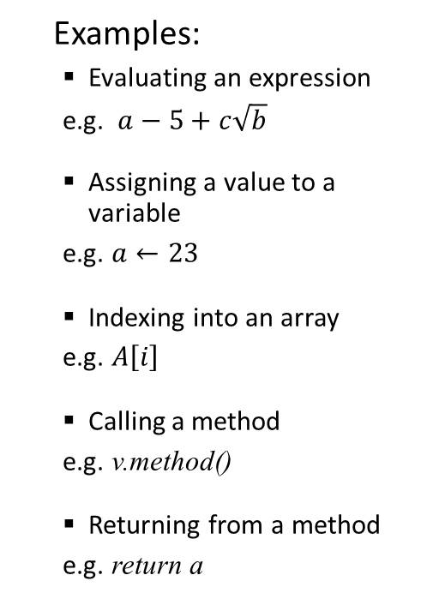
Primitive operations
Basic computations performed by an algorithm
Identifiable in pseudocode
Largely independent of the programming language
Exact definition not important (we will see why later)
Take a constant amount of time in the RAM model (one unit of time or constant time)
Examples:
Evaluating an expression
e.g. $a−5+c\sqrt{b}$
Assigning a value to a variable
e.g. $a←23$
Indexing into an array
e.g. $A\left[i\right]$
Calling a method
e.g. v.method()
Returning from a method
e.g. return a
Counting primitive operations:
Algorithm arrayMax(A, n)
# operations
currentMax ← A[0] 2
for i ← 1 to n − 1 do 2n
if A[i] > currentMax then 2(n − 1)
currentMax ← A[i] 2(n − 1)
{ increment counter i } 2(n − 1)
return currentMax 1 _
Total: T(n) = 8n − 3
Notes:
By inspecting the pseudocode, we can determine the maximum number of primitive operations executed by an algorithm, as a function of the input size

Slide 13
Case analysis
Experimental analysis
Three cases
Worst case:
among all possible inputs, the one which takes the largest amount of time.
Best case:
The input for which the algorithm runs the fastest
Average case:
The average is over all possible inputs
Can be considered as the expected value of T(n), which is a random variable
Running time
Input number
Notes:
The same algorithm is run over different inputs

Slide 14
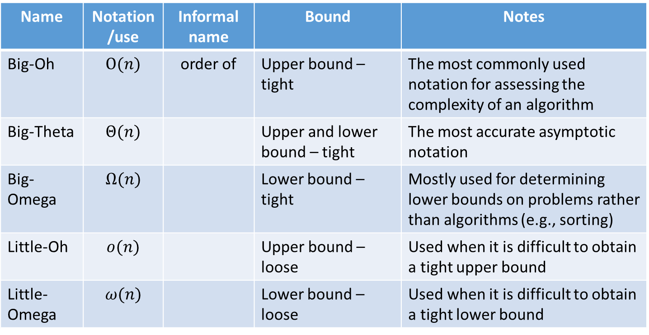
Asymptotic notation
Name | Notation/use | Informal name | Bound | Notes
Big-Oh | $$Ο(n)$$ | order of | Upper bound – tight | The most commonly used notation for assessing the complexity of an algorithm
Big-Theta | $$Θ(n)$$ |  | Upper and lower bound – tight | The most accurate asymptotic notation
Big-Omega | $$Ω(n)$$ |  | Lower bound – tight | Mostly used for determining lower bounds on problems rather than algorithms (e.g., sorting)
Little-Oh | $$ο(n)$$ |  | Upper bound – loose | Used when it is difficult to obtain a tight upper bound
Little-Omega | $$ω(n)$$ |  | Lower bound – loose | Used when it is difficult to obtain a tight lower bound

Slide 15
Big-Oh notation
Given functions f(n) and g(n), we say that f(n) is O(g(n)) if there are positive constants c and n₀ such that
f(n) ≤ cg(n) for n ≥ n₀
Example: 2n + 10 is O(n)
2n + 10 ≤ cn
(c − 2) n ≥ 10
n ≥ 10/(c − 2)
Pick c = 3 and n₀ = 10
It follows that
2n + 10 ≤ 3n for n ≥ 10
cg(n) = 3n
f(n) = 2n + 10
g(n) = n

Slide 16
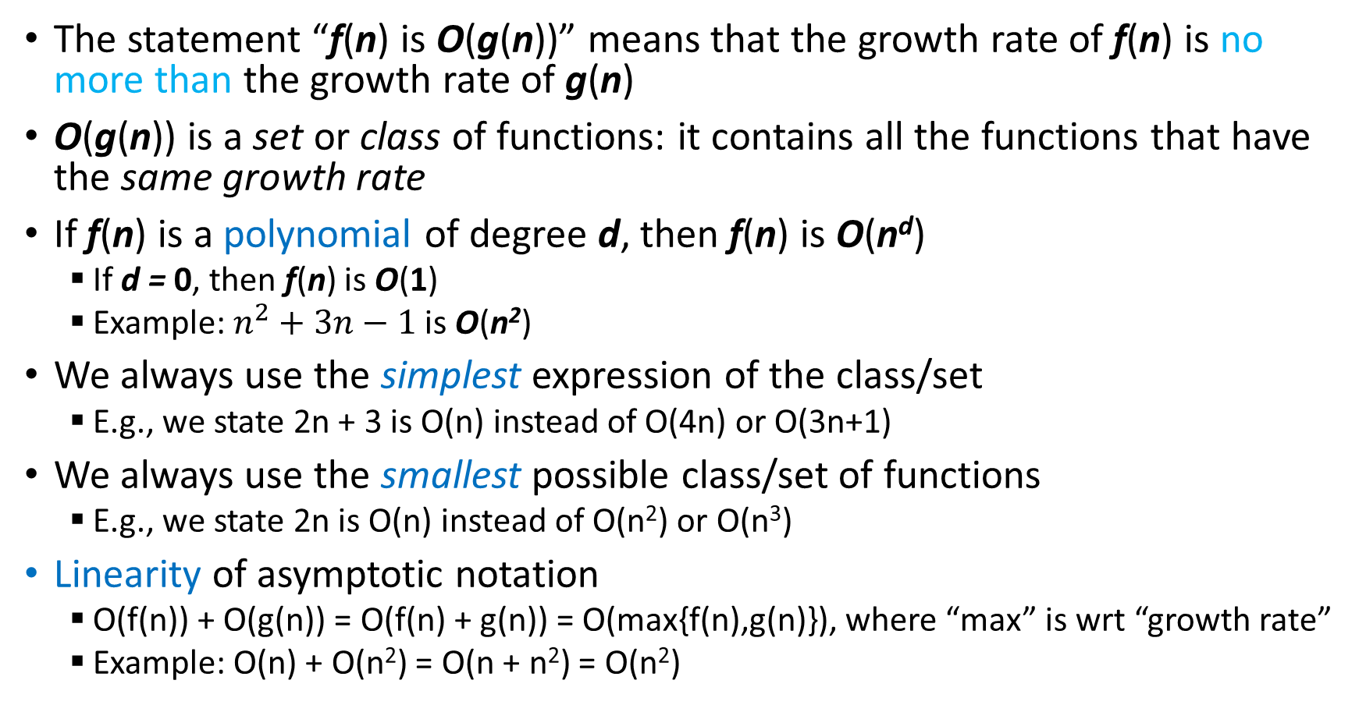
Big-Oh rules - properties
The statement “f(n) is O(g(n))” means that the growth rate of f(n) is no more than the growth rate of g(n)
O(g(n)) is a set or class of functions: it contains all the functions that have the same growth rate
If f(n) is a polynomial of degree d, then f(n) is O(n^{d})
If d = 0, then f(n) is O(1)
Example: $n^{2}+3n−1$ is O(n²)
We always use the simplest expression of the class/set
E.g., we state 2n + 3 is O(n) instead of O(4n) or O(3n+1)
We always use the smallest possible class/set of functions
E.g., we state 2n is O(n) instead of O(n²) or O(n³)
Linearity of asymptotic notation
O(f(n)) + O(g(n)) = O(f(n) + g(n)) = O(max{f(n),g(n)}), where “max” is wrt “growth rate”
Example: O(n) + O(n²) = O(n + n²) = O(n²)

Slide 17
Big-Omega and Big-Theta notations
big-Omega
f(n) is Ω(g(n)) if there is a constant c > 0 and an integer constant n₀ ≥ 1 such that f(n) ≥ c g(n) for n ≥ n₀
Example: 3n³ – 2n + 1 is Ω(n³)
big-Theta
f(n) is Θ(g(n)) if there are constants c’ > 0 and c’’ > 0 and an integer constant n₀ ≥ 1 such that c’ g(n) ≤ f(n) ≤ c’’ g(n) for n ≥ n₀
Example: 5n log n – 2n is Θ(n log n)
Important axiom:
f(n) is O(g(n)) and Ω(g(n)) ⇔ f(n) is Θ(g(n)
Example: 5n² is O(n²) and Ω(n²) ⇔ 5n² is Θ(n²)

Slide 18
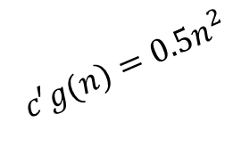
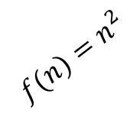
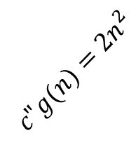
Asymptotic notation – graphical comparison
Big-Oh
f(n) is O(g(n)) if f(n) is asymptotically less than or equal to g(n)
Big-Omega
f(n) is Ω(g(n)) if f(n) is asymptotically greater than or equal to g(n)
Big-Theta
f(n) is Θ(g(n)) if f(n) is asymptotically equal to g(n)
Normal scale:
Log-log scale:
$$c"g(n)=2n^{2}$$
$$f(n)=n^{2}$$
$$c′g(n)=0.5n^{2}$$

Slide 19
Little-Oh and Little-Omega notations
Little-Oh
f(n) is o(g(n)) if for any constant c > 0, there is a constant n₀ > 0 such that f(n) < c g(n) for n ≥ n₀
Example: 3n² – 2n + 1 is o(n³), while 3n² – 2n + 1 is not o(n²)
Little-Omega
f(n) is ω(g(n)) if for any constant c > 0, there is a constant n₀ > 0 such that f(n) > c g(n) for n ≥ n₀
Example: 3n² – 2n + 1 is ω(n), while 3n² – 2n + 1 is not ω(n²)
Important axiom:
f(n) is o(g(n)) ⇔ g(n) is ω(f(n))
Comparison with O and Ω
For O and Ω, the inequality holds if there exists a constant c > 0
For o and ω , the inequality holds for all constants c > 0
Notes:
3n² – 2n + 1 is o(n³):
To show that 3n³ – 2n + 1 is o(n³), we must show that for any constant c > 0 there is n₀ > 0 for which the 3n² – 2n + 1 ≤ c n³.
Let c > 0 be any constant. Take n₀ = (3+2+1)/c. Then, for n ≥ n₀ we have:
cn³ ≥ 3n² + 2n² +n² ≥ 3n² + 2n + 1 ≥ 3n² – 2n + 1
3n² – 2n + 1 is ω(n³):
Let c > 0 be any constant. Take n₀ = c. Then, for n ≥ n₀ we have:
3n² - 2n + 1 ≥ 3n - 2n + 1 ≥ cn
3n² – 2n + 1 is not o(n²):
To show that 3n² – 2n + 1 is o(n²), we must show that for any constant c > 0 there is n₀ > 0 for which the 3n² – 2n + 1 ≤ c n².
Let c = 1/(3+2+1) = 1/6. Then, cn2 = (1/6)n², and there is no n₀ > 0 for which (1/6)n² ≥ 3n² – 2n + 1

Slide 20
Case study 1: Search in a Map (sorted list)
Problem: Given a sorted array S of integers (a map), find a key k in that map.
One of the most important problems in computer science
Solution 1: Linear search
Scan the elements in the list one by one
Until the key k is found
Example:
Linear search runs in linear time.
Algorithm linearSearch(S, k, n):
Input: Sorted array S of size n, and key k
Output: Null or the element found
i ← 0
while i < n and S[i]!= k
i ← i + 1
if i = n then
return null
else
e ← S[i]
return e
Worst-case running time: T(n) = 3n + 4 ➔ T(n) is O(n)
S[i]
8 | 12 | 19 | 22 | 23 | 34 | 41 | 48
0 | 1 | 2 | 3 | 4 | 5 | 6 | 7
i

Slide 21
Case study 1: Search in a Map (sorted list)
Problem: Given a sorted array of integers (a map), find a key k in that map.
Solution 2: Binary search
Binary search runs in logarithmic time
Same problem:
Two algorithms run in different times
Algorithm binarySearch(S, k, low, high):
Input: A key k
Output: Null or the element found
if low > high then
return null
else
mid ← ⎣(low + high) / 2⎦
e ← S[mid]
if k = e.getKey() then
return e
else if k < e.getKey() then
return binarySearch(S, k, low, mid-1)
else
return binarySearch(S, k, mid+1, high)
Worst-case running time: T(n) = T(n/2) + 1 ➔ T(n) is O(log n)
S[i]
8 | 12 | 19 | 22 | 23 | 34 | 41 | 48
0 | 1 | 2 | 3 | 4 | 5 | 6 | 7
i

Slide 22

Case study 2: Prefix averages
The i-th prefix average of an array S is the average of the first (i + 1) elements of S:
A[i] = (S[0] + S[1] + … + S[i])/(i+1)
Problem: Compute the array A of prefix averages of another array S
Has applications in financial analysis
Solution 1: A quadratic-time algorithm: quadPrefixAve
Example:
Algorithm quadPrefixAve(S, n)
Input: array S of n integers
Output: array A of prefix averages of S #operations
A ← new array of n integers n
for i ← 0 to n - 1 do n
s ← S[0] n – 1
for j ← 1 to i do 1 + 2 + …+ (n - 1)
s ← s + S[j] 1 + 2 + …+ (n - 1)
A[i] ← s / (i + 1) n - 1
return A 1
T₂(n) = 2n + 2(n-1) + 2n(n-1)/2 + 1 is O(n²)
$$\frac{n(n−1)}{2}$$
S
21 | 23 | 25 | 31 | 20 | 18 | 16
0 | 1 | 2 | 3 | 4 | 5 | 6
A
21 | 22 | 23 | 25 | 24 | 23 | 22
0 | 1 | 2 | 3 | 4 | 5 | 6

Slide 23
Case study 2: Prefix averages
Solution 2: A linear-time algorithm: linearPrefixAve
For each element being scanned, keep the running sum
Algorithm linearPrefixAve(S, n)
Input: array S of n integers
Output: array A of prefix averages of S #operations
A ← new array of n integers n
s ← 0 1
for i ← 0 to n - 1 do n
s ← s + S[i] n – 1
A[i] ← s / (i + 1) n – 1
return A 1
T₂(n) = 4n is O(n)
S
21 | 23 | 25 | 31 | 20 | 18 | 16
0 | 1 | 2 | 3 | 4 | 5 | 6
A
21 | 22 | 23 | 25 | 24 | 23 | 22
0 | 1 | 2 | 3 | 4 | 5 | 6

Slide 24
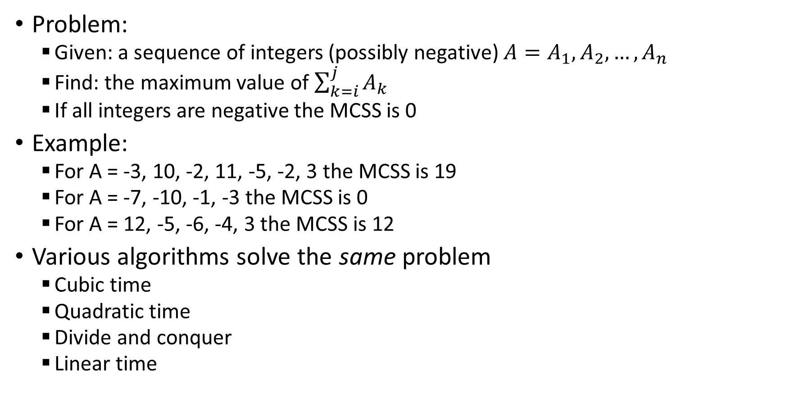
Case study 3: Maximum contiguous subsequence sum (MCSS)
Problem:
Given: a sequence of integers (possibly negative) ${A=A}_{1},A_{2},…,A_{n}$
Find: the maximum value of $\sum_{k=i}^{j}{A_{k}}$
If all integers are negative the MCSS is 0
Example:
For A = -3, 10, -2, 11, -5, -2, 3 the MCSS is 19
For A = -7, -10, -1, -3 the MCSS is 0
For A = 12, -5, -6, -4, 3 the MCSS is 12
Various algorithms solve the same problem
Cubic time
Quadratic time
Divide and conquer
Linear time

Slide 25
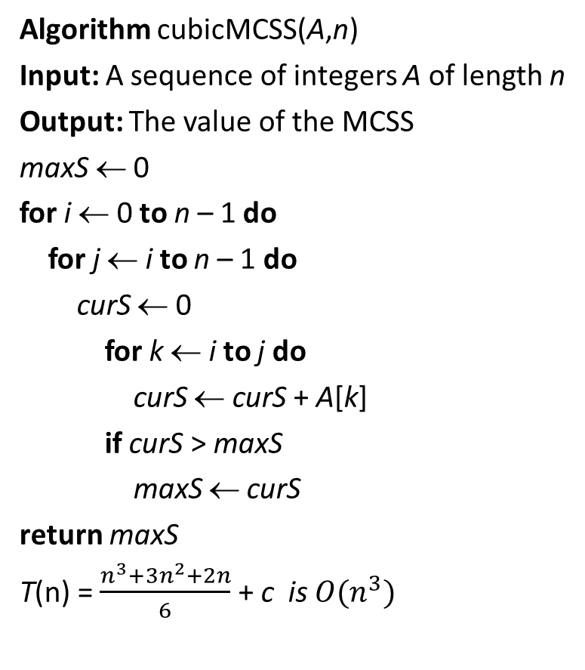



MCSS: Cubic vs quadratic time algorithms
Algorithm cubicMCSS(A,n)
Input: A sequence of integers A of length n
Output: The value of the MCSS
maxS ← 0
for i ← 0 to n – 1 do
for j ← i to n – 1 do
curS ← 0
for k ← i to j do
curS ← curS + A[k]
if curS > maxS
maxS ← curS
return maxS
T(n) = $\frac{n^{3}+3n^{2}+2n}{6}$ + c is $O(n^{3})$
Algorithm quadraticMCSS(A,n)
Input: A sequence of integers A of length n
Output: The value of the MCSS
maxS ← 0
for i ← 0 to n – 1 do
for j ← i to n – 1 do
curS ← curS + A[j]
if curS > maxS
maxS ← curS
return maxS
$$∝\frac{n(n−1)}{2}$$
$$\sum_{i=0}^{n−1}{}\sum_{j=i}^{n−1}{}\sum_{k=i}^{j}{1}=\frac{n^{3}+3n^{2}+2n}{6}$$
The double sum will give $O(n^{2})$
Example: for A = -3, 10, -2, 11, -5, -2, 3 the MCSS is 19
Notes:
In the quadratic algorithm, the double sum gives a number of steps proportional to $\frac{n(n−1)}{2}$, which is $O(n^{2})$. This can be proved by induction (see the slide on proving by induction).
For the cubic algorithm, we have:
$\sum_{i=0}^{n−1}{}\sum_{j=i}^{n−1}{}\sum_{k=i}^{j}{1}=\frac{n^{3}+3n^{2}+2n}{6}$ can be proved by double induction on i and j.
First, we should prove that $\sum_{j=i}^{n−1}{\left(j−i+1\right)=\frac{(n−i+1)(n−i)}{2}}$.
Then, we should prove that $\sum_{i=0}^{n−1}{\frac{(n−i+1)(n−i)}{2}}=\frac{n^{3}+3n^{2}+2n}{6}$
A direct proof can be found in (Weiss, 2012)

Slide 26
MCSS: Divide and conquer
Main features:
Rather lengthy
Split the sequence into two
Algorithm:
Divide subsequence into two halves
Find max left border sum (left arrow)
Find max right border sum (right arrow)
Return the sum of both maximums as the max sum
Do this recursively for each half
Complexity given by T(n) = 2T(n/2) + n, where T(1) = 1
Runs in O(n log n)
First half
Second half
A = -3, 10, -2, 11, -1, 2, -3
MCSS spans both halves
Notes:
Finding the O-notation of functions like T(n) = 2T(n/2) + n will be studied later in Chapter 5.

Slide 27

Linear time algorithm
Tricky parts of this algorithm are:
No MCSS will start or end with a negative number
We only find the value of the MCSS
But if we need the actual subsequence, we’ll need to resort on at least divide and conquer
Algorithm linearMCSS(A,n)
Input: A sequence of integers A of length n
Output: The value of the MCSS
maxS ← 0; curS ← 0
for j ← 0 to n – 1 do
curS ← curS + A[j]
if curS > maxS
maxS ← curS
else
if curS < 0
curS ← 0
return maxS
Example: for A = -3, 10, -2, 11, -5, -2, 3 the MCSS is 19
The single for loop gives $O(n)$

Slide 28
Example: Best vs worst case
Loops:
Worst Case: take maximum
Best Case: take minimum
 | worst | best
i ← 0 | 1 | 1
while i < n and A[i] != 7 | n | 1
i ← i + 1 | n | 0
 | O(n) | O(1)
Worst-case input:
3 | 1 | 4 | 2 | 3 | 2 | 1 | 8
0 | 1 | 2 | 3 | 4 | 5 | 6 | 7
n
Best-case input:
7 | 1 | 5 | 4 | 8 | 2 | 1 | 9
0 | 1 | 2 | 3 | 4 | 5 | 6 | 7
n
Notes:
In worst case analysis, we take the maximum number of operations that the algorithm would execute. In conditional statements such as “if”, we take the maximum between “then” and “else”.
In conditional statements like “while”, we take the maximum number of times the while loop will be executed when the conditions are true. In the example above, it will be when 7 is not in the array. In that case, the while will be executed until the end of the array is reached, which gives cn operations.

Slide 29
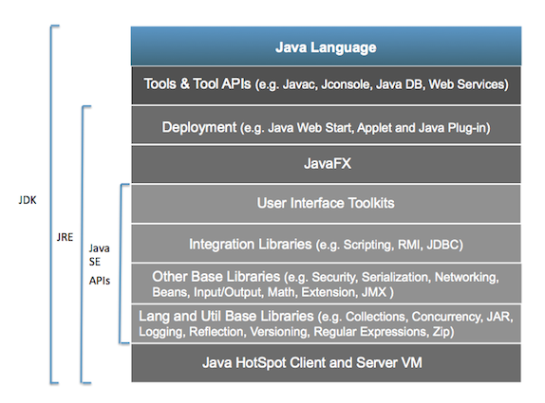
Our programming language: Java
According to Sun’s Java developers:
“Java is a simple, object-oriented, distributed, secure, architecture, robust, multi threaded and dynamic language. The program can be written once, and run anywhere”
It runs on the Java Virtual Machine (JVM)
Main features of Java 8
Object is the main data type, and can be as general as we wanted:
public Object read()
Public void write(Object x)
Classes and Interfaces can be generic too:
public class MyClass<AnyType> { public AnyType read() {…} ….
Static methods can be generic too
Public static <AnyType> boolean find(AnyType [] a, AnyType x) { … }
Generic classes/objects have some restrictions (primitive types, and others)
Java SE Conceptual Diagram
Notes:
Source: http://www.oracle.com/technetwork/topics/newtojava/documentation/index.html - June 2015

Slide 30


Java – some facts*
10 Million Java Developers Worldwide
#1 Choice for Developers
#1 development platform in the cloud
5 million students study Java
2nd most important programming language for IEEE Spectrum
*Source: www.java.com – June 2017
Notes:
*Source: www.java.com – June 2015

Slide 31
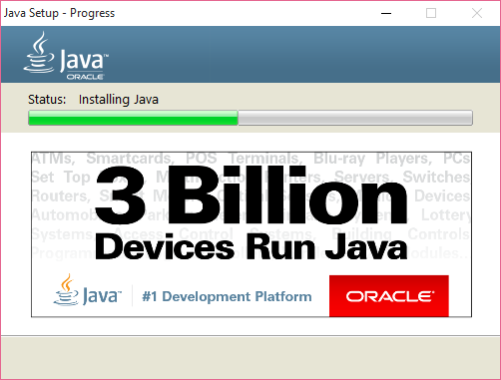
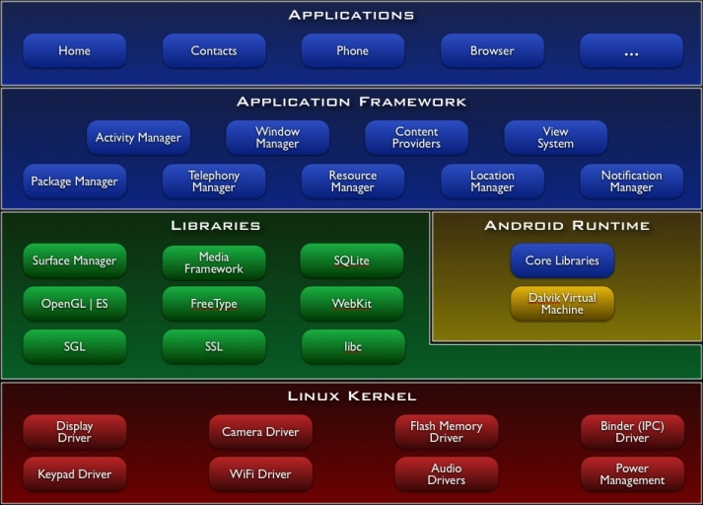
Java – more facts
Java installation window Android apps are written in Java

Slide 32
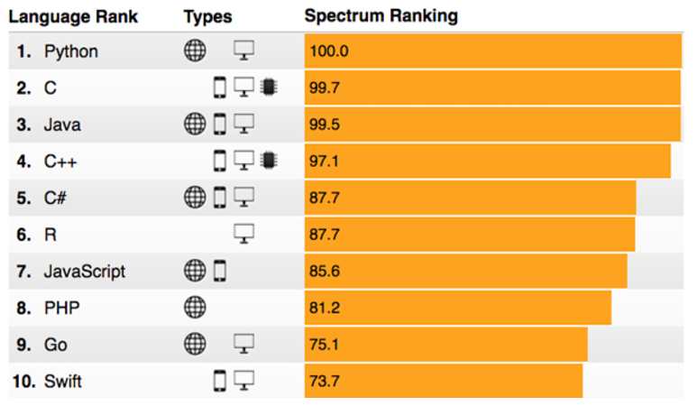
Java – even more…
Java ranked the among the top programming languages of 2017 by IEEE Spectrum
http://spectrum.ieee.org/static/interactive-the-top-programming-languages-2017

Slide 33

Java SE and EE 8
Our implementations will use Java Standard Edition (Java SE 8)
http://www.oracle.com/technetwork/java/javase/overview/index.html
A more advanced edition is the Java Enterprise Edition (Java EE 8)
http://www.oracle.com/technetwork/java/javaee/overview/index.html
Java EE is developed using the Java Community Process
Includes contributions from experts (industry, commercial, organizations, etc.)
Releases and new features are aligned with contributors
Main features:
a rich platform, widely used, scalable, low risk, etc.
enhances HTML5 support and increase developer productivity
Java EE 8 developers have support for latest Web applications and frameworks
*Image from www.oracle.com
Notes:
Note that all of our Java implementations will be run on the Standard Edition (Java SE 8).

Slide 34

Eclipse
Main features
IDE and Tools
Desktop IDEs: Supports Java Integrated Development Environment (IDE), PHP, Java SE/EE, C/C++
Web IDEs: Software placed in the cloud, and accessed from anywhere (desktop, laptop or tablet)
Community of Projects
Can participate and contribute to other projects
Collaborative Working Groups
It’s an open industry collaboration used to develop new industry platforms
Current groups include automotive, location tech, science, long-term support, Internet of Things (IoT), PolarSys (embedded systems)

Slide 35
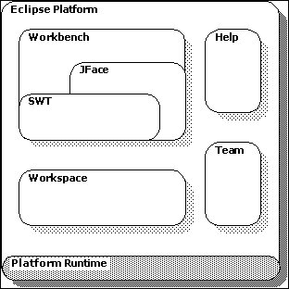
Eclipse – main platform
Eclipse platform is structured as a set of components implemented through plug-ins
Components are built on top of a small runtime engine
The Workbench is the desktop development environment
It’s an integration tool for creation, management, and navigation of workspace resources
Notes:
SWT: Standard Widget Toolkit. SWT is an open source widget toolkit for Java designed to provide efficient, portable access to the user-interface facilities of the operating systems

Slide 36
Review and Further Reading
Math and proofs:
Arithmetic and geometric series
Summations
Logarithms and properties
Proofs and justifications
Basic probability
Section 1.2 of [3] and Sections 1.1, 1.2, 1.3, 1.4 and 1.6 of [1]
Appendices A and C of [5].
Algorithm analysis:
Ch. 4 of [2], Ch. 2 of [4], Ch. 3 of [5]
Java
Main sites by Oracle: [7],[8],[9]
Eclipse
Main site: [6]. Basic tutorial: Eclipse > Workbench User Guide > Getting started

Slide 37
References
Algorithm Design and Applications by M. Goodrich and R. Tamassia, Wiley, 2015.
Data Structures and Algorithms in Java, 6th Edition, by M. Goodrich and R. Tamassia, Wiley, 2014. (On reserve in the Leddy Library)
Data Structures and Algorithm Analysis in Java, 3rd Edition, by M. Weiss, Addison-Wesley, 2012.
Algorithm Design by J. Kleinberg and E. Tardos, Addison-Wesley, 2006.
Introduction to Algorithms, 2nd Edition, by T. Cormen et al., McGraw-Hill, 2001.
The Eclipse Foundation, http://www.eclipse.org/
Java by Oracle: http://www.oracle.com/technetwork/java/index.html
Java Standard Edition (Java SE 8) http://www.oracle.com/technetwork/java/javaee/overview/index.html
Java Enterprise Edition (Java EE 8) http://www.oracle.com/technetwork/java/javaee/overview/index.html

Slide 38
Lab – Practice
Use the class MaxSumTest.java provided in the source code.
Create a new Java project in Eclipse (called “Algorithm Analysis”)
Create a new package called “analysis”
Create a new class called MaxSumTest and enter the provided source code.
Run the four algorithms with the example provided in the source code.
Create random sequences of n integers between –n/2 and +3n/2
Run the program of 1.e for n = 2^{i} , where i = 3, 4, …, 16, and record the CPU time for each algorithm and each value of i
Create a table with the times obtained and discuss these. Compare the CPU times with the complexity (running time) of the algorithms
Plot the CPU times obtained for each algorithm and compare the plots with those of the most important functions used in algorithm analysis (slide 11)
*Repeat all items of #1 for the Prefix Averages problem.
In this case, you will have to implement the two algorithms (as they are not provided).

Slide 39
Exercises
Sort the functions 12n², 3n, 0.5 log n, n log n, 2n³ in increasing order of growth rate.
Algorithm A uses 20 n log n operations, while algorithm B uses 2n² operations. Assume all operations take the same time. What is the value of n0 for which A will run faster? Which algorithm will you use if your inputs are of size 10,000?
*Prove or disprove that (a) f(n) = 2n² + 3 is O(n), (b) f(n) is O(n¹⁰), (c) f(n) is Ω(1), (d) f(n) is ω(1), (e) f(n) is ω(n^{0.5}), (f) f(n) Θ(n²), (e) f(n) is o(n^{9/4}).
Consider A = 3, 4, -7, 3, 6, -3, 2, 8, -1. Find the MCCS using the four algorithms discussed in class. *How many operations will the linear-time algorithm use?
Find the worst-case running time in O-notation for algorithms linearMCCS and quadraticMCCS. Show all steps used in the calculations. What about Ω and Θ? Also, ω and o?
*Implement linearMCCS and divide-and-conquer-MCCS. Run them on several random sequences of size 1,000. Which one is faster? What are the inputs for which the algorithms run faster/slower? Take the average CPU times and compare the with the running times of the algorithms.
Are these statements true? (a) If f(n) is O(g(n)), then f(n) is Ω(g(n)); (b) if f(n) is O(g(n)), then g(n) is Ω(f(n)); (c) if f(n) is O(g(n)) and f(n) is Ω(g(n)), then f(n) is Θ(g(n)); (d) if f(n) is O(g(n)) and g(n) is Ω(f(n)), then f(n) is Θ(g(n)); (e) if f(n) is o(g(n)), then f(n) is O(g(n)); (f) if f(n) is Ω(g(n)), then f(n) is ω(g(n)).
Give five different reasons for why we use Java in this course.
Describe the main features of the Eclipse IDE platform.
What is the advantage of using Java Enterprise Edition?
Consider A = 3, 4, -7, 3, 6, -3, 2, 8, -1. Can the algorithm linearMCCS be modified to run a little bit faster on this example? Yes/no? why not?
Give an example of an algorithm whose best and worst case running times differ in more than a constant (i.e., asymptotically different).
*Implement linear search and binary search on an array A. Run a variety experiments on different lists of different sizes. Which algorithm will you use and for which sizes?
List the main properties of the rules for O-notation. Do these apply to Ω and Θ? How?
What is the difference between problem and algorithm? Explain how a problem can be solved using different algorithms and how they may have different complexities. Give an example.
Give examples of functions for the different types of asymptotic notation.

